Slide 1


Slide 2
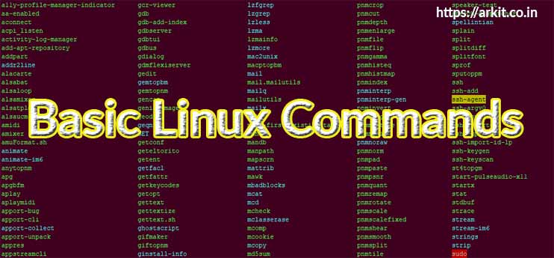

Slide 3
Pwd :- (Print working directories) This command returns with present working directories.
Eg :-pwd
/home/test
Ls :-The ls(List) command – function in the linux terminal to show all of the major directories field under a given file system.
eg– ls/application
Options :
-l display file or directory size, owner, group, and their permission.
-a display the hidden files.
-r sort the files in reverse order.
--help shows the help related to ls.

Slide 4
man:-- The manual command is used to show the manual of the inputted command .the man command will show you all infomation about the command you are using.
Eg—man cd
mkdir:-- the make directory command allow the user to make a new directory.
eg – mkdir test
rmdir:- the remove directories command remove each and every directory specified on the command line.
eg -- rmdir test
rm:- The remove command is meant to remove files or directory from your linux operating system.

Slide 5
Cd :- The cd command(change directories) will allow the user to change between file directories
eg cd/arora/test
mv:- The move command allow user to move a file to another folder or directory.
eg– mv text new
cp– cp used to copy the file through the command line. it takes two argument. The first is the location of the file to be copied, the second is where to copy.
Sort– sorting lines of text files in ascending order.
-r : will sort in descending order.

Slide 6
Find– Find command used to search files. strings and directories.
Eg– find/-name test
Touch– The touch command is used to create a file.it can be anything, from an empty txt file to an empty zip file

Slide 7
Intermidiate Commands
Echo – The echo command helps us move some data , usually text into a file.
Eg- “echo hello,my name is alok>> new.txt”.
cat- Use the cat command to display the contents of a file.
Eg:- cat test
df:- Use the df command to see the available disk space in each of the partitions in your system.
Eg: “df-m”.
Hostname- It displays your hostname and IP address.

Slide 8
Du:- use du command to know the disk usage of a file in your system.
Eg:- du test1(filename)
Uname-- Use uname command to show the information about the system.
Eg:- uname –a
it will print most of the information about the system. This prints the Kernal release data,version,processor type,etc.

Slide 9


